Slide 1
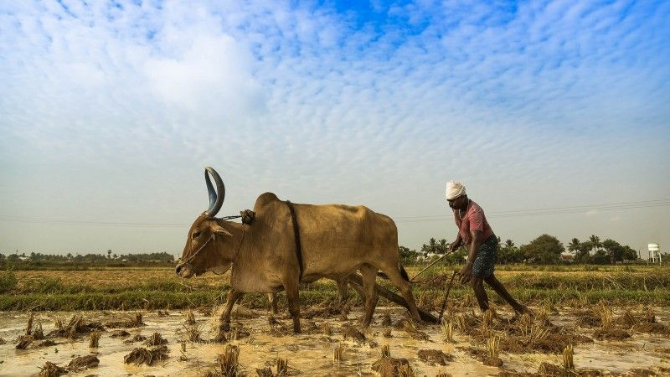
Indian Agricultural Data Analysis
Using Power BI
-Aishwarya A Sardeshpande

Slide 2
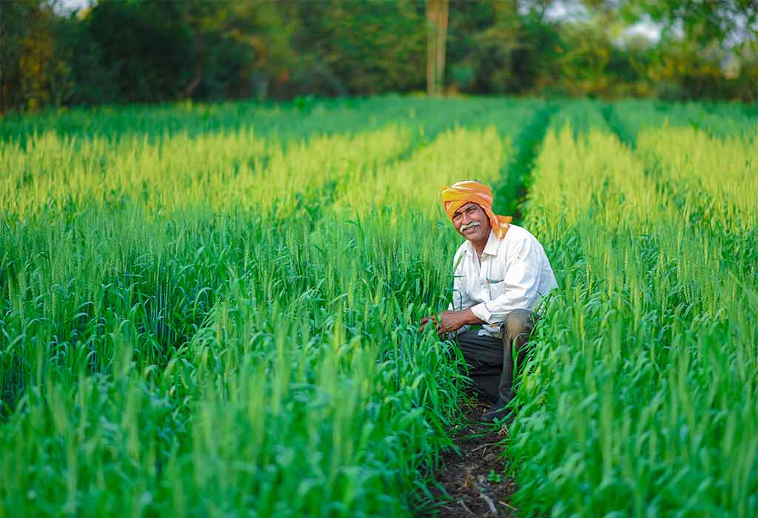
Contents Covered
Introduction.
Brief on Datasets.
Analysis of data.
Conclusion.

Slide 3
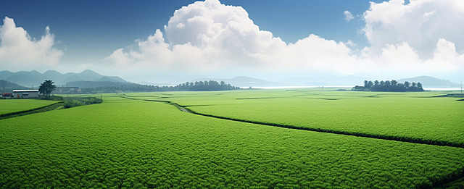
INTRODUCTION
Indian agriculture, spanning diverse regions, cultivates a rich tapestry of crops crucial for the nation's sustenance. From staple grains like wheat and rice to cash crops like cotton and sugarcane, each corner of the country contributes uniquely to its agricultural wealth. Yet, amidst this diversity, one unifying truth emerges: the farmer stands as the unwavering backbone of our nation, their resilience and dedication ensuring food security and economic stability, embodying the enduring spirit of Indian agriculture.

Slide 4
INTRODUCTION
The dataset utilized in this project encompasses a comprehensive range of agricultural statistics spanning from 1966 to 2017. It includes information on the number of states and districts, offering insights into the geographical distribution of agricultural activities. Moreover, the dataset provides detailed records on the cultivation of pulses, cereals, oilseeds, and commercial crops across various regions of India. Additionally, it covers data on fodder areas, as well as the cultivation of vegetables and fruits, including production and yield rates measured in hectares. Furthermore, the dataset examines the impact of the Rabi and Kharif seasons on crop growth, shedding light on seasonal variations and their influence on agricultural output.

Slide 5
Brief on Datasets
Year | Ground nut
State name | Sesamum
State code | Rapeseed
District name | Safflower
District code | Castor
Rice | Linseed
Wheat | Sunflower
Sorghum | Soya beans
Pearl Millet | Oil seeds
Maize | Sugar cane
Finger Millet | Cotton
Barley | Fruit and vegetable area
Chickpea | Onion areas
Pigeonpea | Potato area
Minor pulses | Fodder area
Year is ranging from 1966 to 2017.
State and district names provided with respective codes.
Lists of cereals, pulses, oil-seeds, commercial crops, fodder area, onion and potato area, fruits, and vegetable area are provided, which are split into:
Area covered by each crop.
Production and yield measured in hectares.

Slide 6
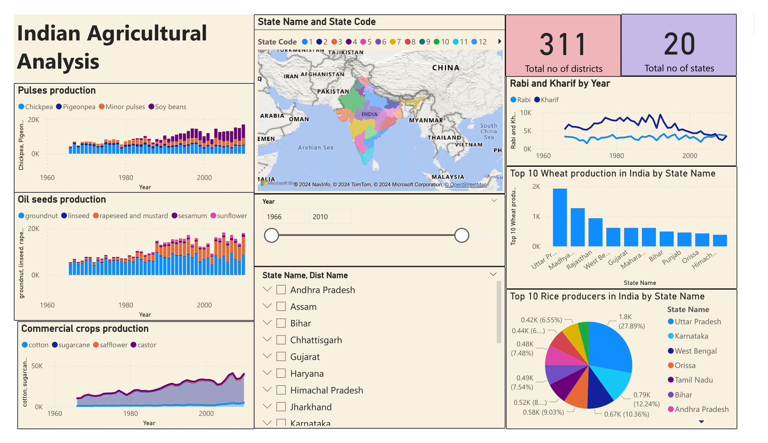
Analysis of data

Slide 7

Analysis of data
After cleaning data using MS Excel and eliminating unwanted spaces , and null elements , we save this file and import it into Power BI .
Before we begin with analysis it is important to mention the title of analysis performed , we use text-box present in visualization tool to type it

Slide 8
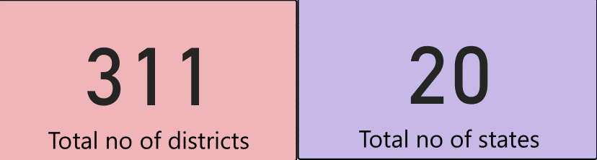
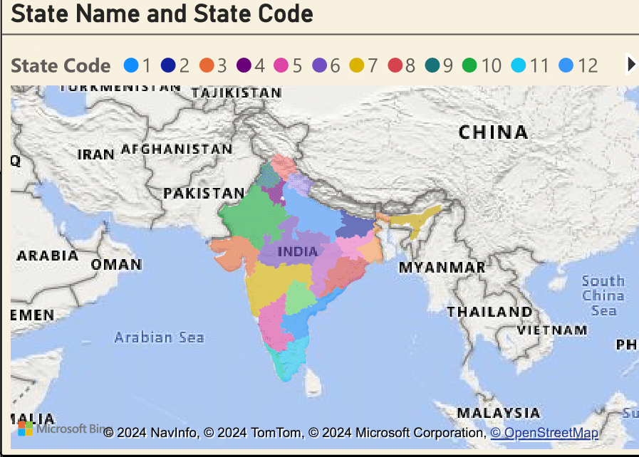
Analysis of data
We have utilized cards to provide total number of states and districts and states .
we got to know there are 20 states and 311 districts altogether in dataset provided.
The card visual is a helpful tool that presents important metrics such as total sales, profit growth, count of opportunities, and performance status.
The filled map visual is a powerful tool for visualizing geographical data, presenting information in a color-coded format based on regions or areas, providing insights into spatial patterns and trends.
We have utilized state name and state code to present it.

Slide 9
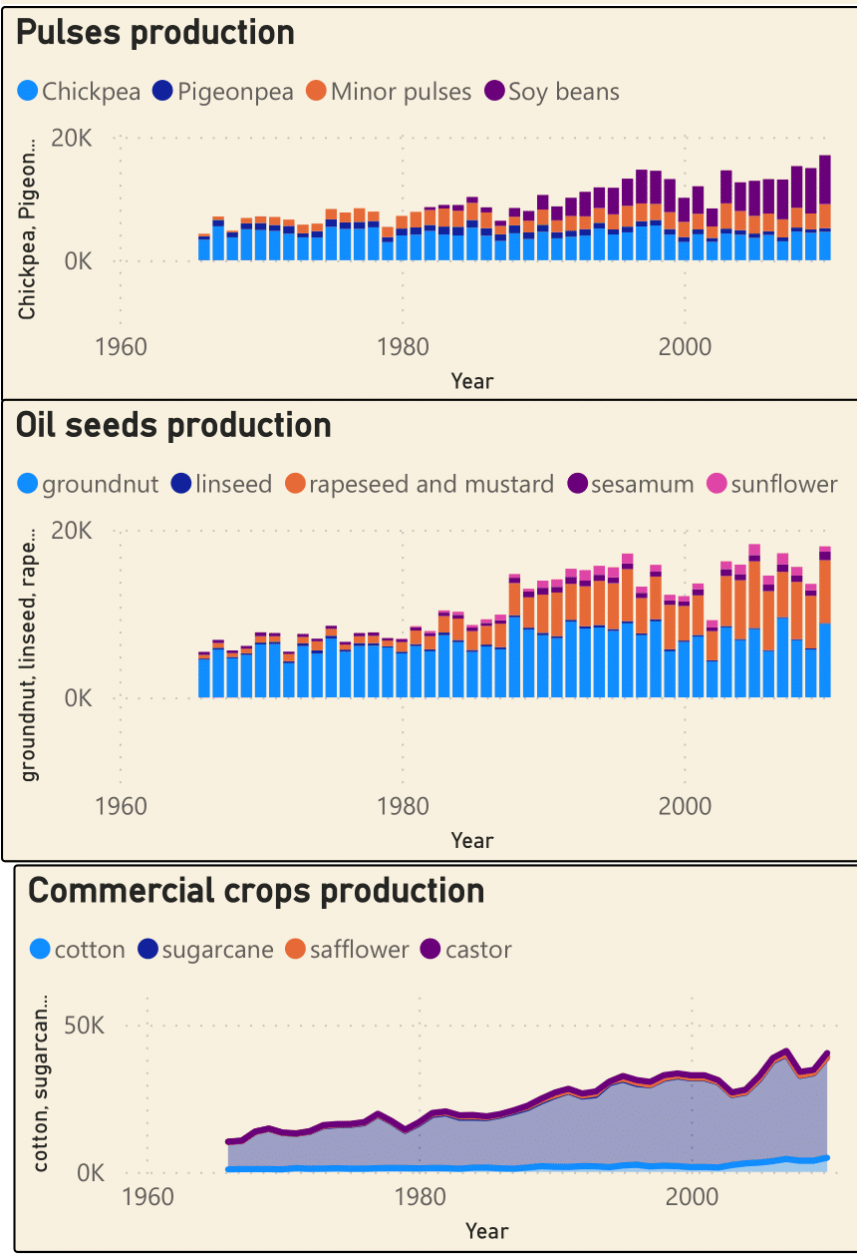
Analysis of data
Stacked column chart used to display data using vertical columns divided into segments , I have utilized two stacked column charts to show how the production of pulses and oil seed production changed over the years in my dataset. Each column represented a year, and the segments inside showed how much of each crop was produced.
A stacked area chart represents cumulative trends over time. I also used a stacked area chart to display the trends in commercial crop production over time. This chart helped me see how the total production of commercial crops changed each year and which crops contributed the most. These visualizations helped me understand how pulses, cereals, and commercial crops were produced over time.

Slide 10
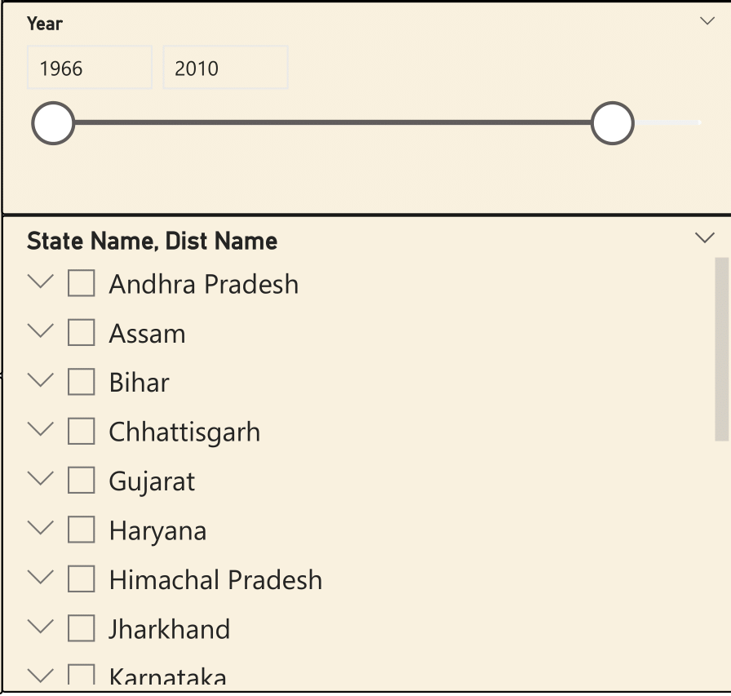
Analysis of data
Slicers are interactive filters in data visualization tools that allow users to select specific values from a dataset, dynamically adjusting the displayed data in connected visuals.
I have utilized slicers to navigate through the dataset, which spans from 1966 to 2017, allowing users to filter data based on specific years. Additionally, I have incorporated slicers to provide dropdown menus for selecting states and districts, enabling users to focus on data from particular regions with ease

Slide 11
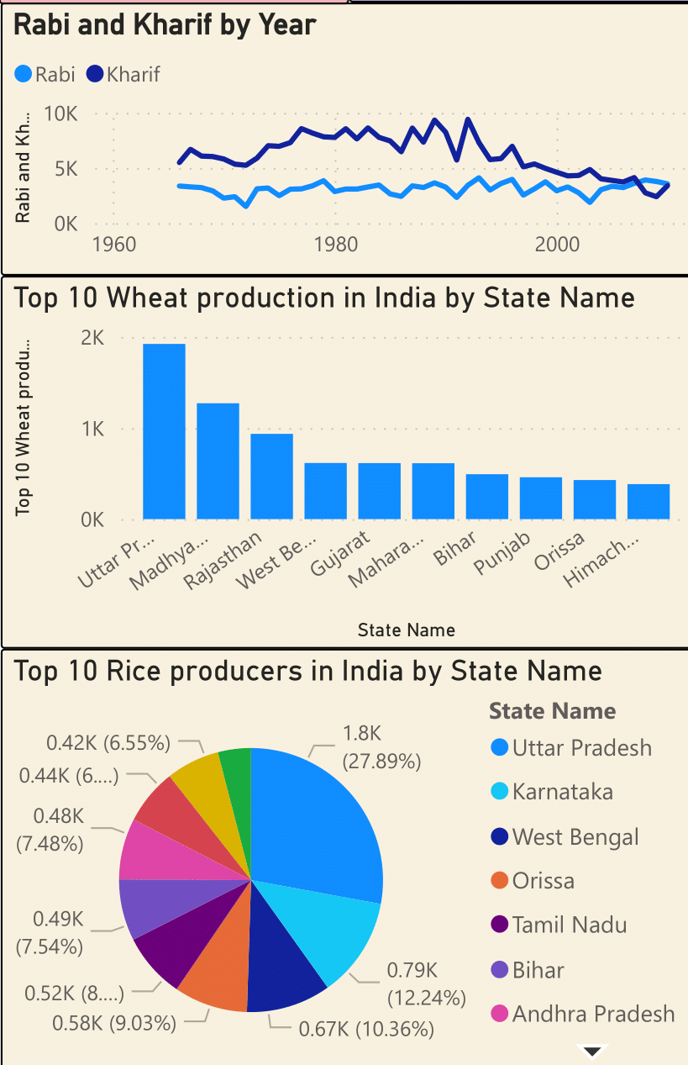
Analysis of data
A line chart represents data points connected by straight lines, commonly used to visualize trends and patterns over time or any continuous interval. I've utilized a line chart to analyze the production of Rabi and Kharif crops over the years, providing insights into the annual variations and trends in agricultural output
A bar chart presents categorical data with rectangular bars, where the length or height of each bar corresponds to the value it represents. I've employed a bar chart to identify the top 10 producing states for wheat, allowing for a clear comparison of production levels across different regions
A pie chart divides a circle into sectors, with each sector representing a proportion of the whole. I've used a pie chart to identify the top 10 producing states for rice, providing a visual representation of each state's contribution to the total rice production.

Slide 12
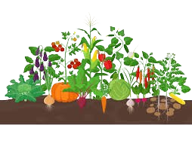
Conclusion
The dataset covers data from 20 states and 311 districts, showing a significant increase in pulses production and notable growth in oilseeds. Karnataka leads in groundnut production, while Uttar Pradesh (UP) ranks highest in wheat and rice production among the top 10 states. Other significant rice producers include West Bengal, Odisha, and Tamil Nadu, while Madhya Pradesh, Rajasthan, Gujarat, and Maharashtra contribute substantially to wheat production. To boost crop cultivation in other regions, efforts should focus on crop diversification, irrigation infrastructure, and access to quality seeds.
To increase crop cultivation in other parts of India, several agricultural measures can be implemented. Firstly, there should be an emphasis on diversification of crops to suit regional climates and soil types, promoting the cultivation of alternative crops suited to specific regions. Investment in irrigation infrastructure and water management systems can help mitigate the impact of erratic rainfall patterns and ensure consistent crop yields. Additionally, providing farmers with access to high-quality seeds, modern agricultural techniques, and crop insurance schemes can incentivize adoption of advanced farming practices and mitigate risks associated with crop failures.

